Slide 1
CHAPTER 3.
ASSEMBLY LANGUAGE PROGRAMMİNG
AND CPU PERIPHERAL INTERFACES
3.1 INTRODUCTION:
A machine language is a collection of the machine instructions represented in 0s and 1s. Assembly language provides easier to use symbolic representation, in which an alphanumeric equivalent to machine language is used. There is a one-to-one correspondence between assembly language statements and machine instructions.
An assembler is a program that accepts a symbolic language program (source program) and produces its machine language equivalent (target program).
Although assembly language programming is difficult compared to programming in high-level languages, it is still important to learn assembly.

Slide 2
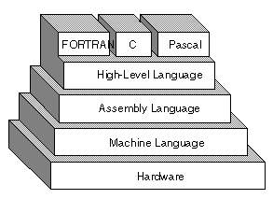
Assembly language: the second generation of programming languages, a programmer writes instructions using symbolic codes, these are meaningful abbreviations and codes.

Slide 3
MOV (Move):
  Assembly: mov eax, ebx
  Machine: 10001011 11011000 00000000 00000000
ADD (Addition):
  Assembly: add eax, 5
  Machine: 10000000 11000000 00000000 00000101
SUB (Subtraction):
  Assembly: sub ecx, 2
  Machine: 10010001 11101001 00000000 00000010
CMP (Compare):
  Assembly: cmp edx, 0
  Machine: 10010111 11001011 00000000 00000000
JMP (Jump):
  Assembly: jmp label
  Machine: 11101011 XXXXXXXX (where XXXXXXXX is the relative offset)

Slide 4
JE (Jump if Equal):
  Assembly: je label
  Machine: 01111000 XXXXXXXX (where XXXXXXXX is the relative offset)
CALL (Call Subroutine):
  Assembly: call subroutine
  Machine: 11101000 XXXXXXXX (where XXXXXXXX is the relative address)
RET (Return from Subroutine):
  Assembly: ret
  Machine: 11000011
PUSH (Push onto Stack):
  Assembly: push eax
  Machine: 01011000
POP (Pop from Stack):
  Assembly: pop ebx
  Machine: 01011101

Slide 5
In some applications, small portions of a program that are heavily used may need to be written in assembly language. Programming in assembly can result in machine code that is smaller and faster than that generated by a compiler of a high-level language. Assembly programmers have access to all the hardware features of the target machine that might not be accessible to high-level language programmers. In addition, learning assembly languages can be of great help in understanding the low level details of computer organization and architecture.

Slide 6
3.2 ASSEMBLY AND EXECUTION OF PROGRAMS
A program written in assembly language needs to be translated into binary machine language before it can be executed.
The assembler reads the source program in assembly language and generates the object program in binary form. The object program is passed to the linker.
The linker will check the object file for calls to procedures in the link library. The linker will combine the required procedures from the link library with the object program and produce the executable program.
The loader loads the executable program into memory and branches the CPU to the starting address. The program begins execution.

Slide 7
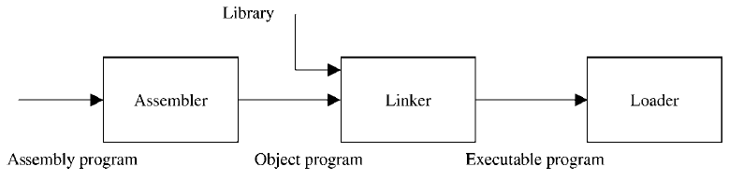
Figure: Assembly and execution process
Assemblers
Assemblers are programs that generate machine code instructions from a source code program written in assembly language. The assembler will replace symbolic addresses by numeric addresses, replace symbolic operation codes by machine operation codes, reserve storage for instructions and data, and translate constants into machine representation.
The functions of the assembler can be performed by scanning the assembly program and mapping its instructions to their machine code equivalent.

Slide 8
Linker and Loader
The linker is the entity that can combine object modules that may have resulted from assembling multiple assembly modules separately. The loader is the operating system utility that reads the executable into memory and start execution.
In summary, after assembly modules are translated into object modules, the functions of the linker and loader prepare the program for execution. These functions include combining object modules together, resolving addresses unknown at assembly time, allocating storage, and finally executing the program.

Slide 9
3.3 CPU PERIPHERAL INTERFACES
A computer consists of a set of components (CPU,memory,I/O) that communicate with each other.
The collection of paths connecting the various modules is called the interconnection structure.
The design of this structure will depend on the exchange that must be made between modules.

Slide 10
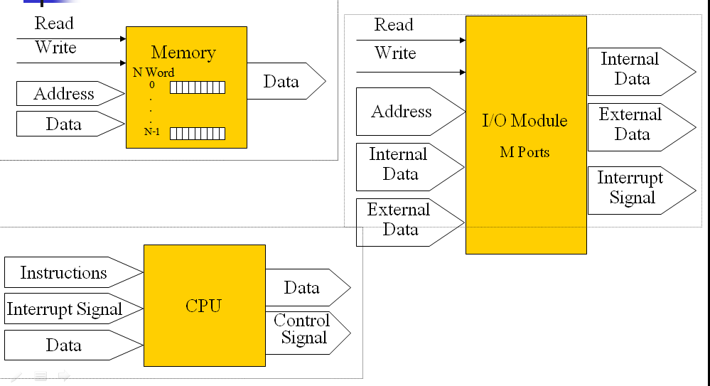
Input/Output for each module

Slide 11
TYPE OF TRANSFERS
Memory to CPU, CPU to Memory, I/O to CPU
CPU to I/O, I/O to or from Memory (DMA : Direct Memory Access )
BUS INTERCONNECTION
A bus is a communication pathway connecting two or more device. A bus is a channel over which information flows. A key characteristic of a bus is that it is a shared transmission medium. A bus consists of multiple pathways or lines. Each line is capable of transmitting signal representing binary digit (1 or 0)

Slide 12
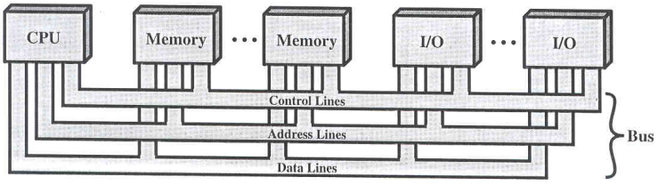
A sequence of bits can be transmit across a single line. Several lines can be used to transmit bits simultaneously (in parallel). A bus that connects major components (CPU,Memory,I/O) is called System Bus. The most common computer interconnection structures are based on the use of one or more system buses.
BUS STRUCTURE
A system bus consists of 50-100 lines. Each line is assigned a particular meaning or function.
On any bus the lines can be classified into 3 groups:
Data lines, Address lines and Control lines.

Slide 13
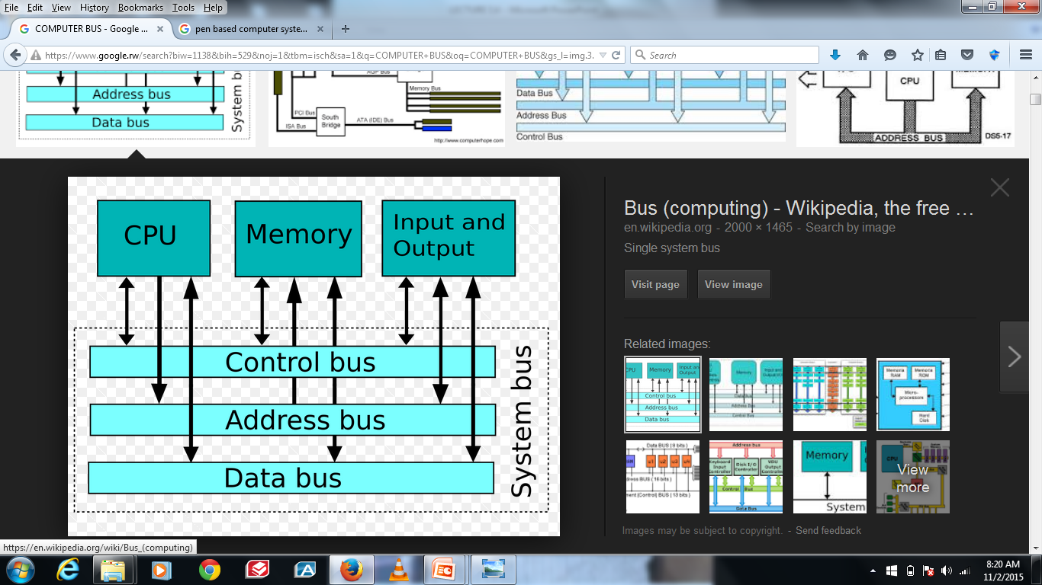
SYSTEM BUS
Data Lines: Provide a path for moving data between system modules. These lines, collectively, are called the data bus that typically consists of 8,16 or 32 separate lines, the numbers of lines being transferred to as the width of the data bus. Each line carry only 1 bit at a time, the number of lines determines how many bits can transferred at a time - overall system performance.

Slide 14
Local bus: is a physical path on which data flows at almost the speed of the microprocessor, increasing total system performance.
Bus line – Paths that transport electrical signals
Bus width – Number of bits of data that can be carried at a time, normally the same as the CPUs word size.
The Address Lines:
Used to designate the source or destination of the data on the data bus, The width of the address bus determines the maximum possible memory capacity of the system.
Larger bus width | = | More powerful computer
CPU can transfer more data at a time | = | Faster computer
CPU can reference larger memory addresses | = | More memory available

Slide 15
THE CONTROL LINES
Used to control the access to and the use of the data and address lines.
Typical control lines include:
Memory write, Memory read, I/O write, I/O read, Clock, Reset, Bus request, Bus grant, Interrupt request, Interrupt ACK, Transfer ACK
THE OPERATION OF THE BUS
- If one module wishes to send data obtain the use of the bus and transfer data via the bus.
- If one module wishes to request data
obtain the use of the bus and transfer request to the other module over the control and address lines, then wait for that second module to send the data.

Slide 16
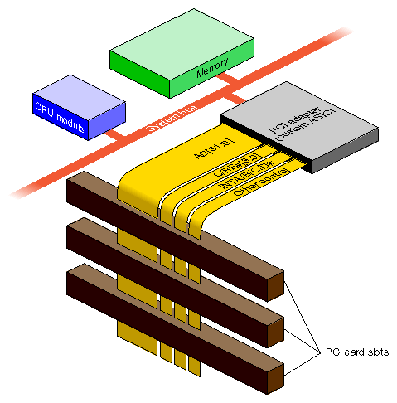


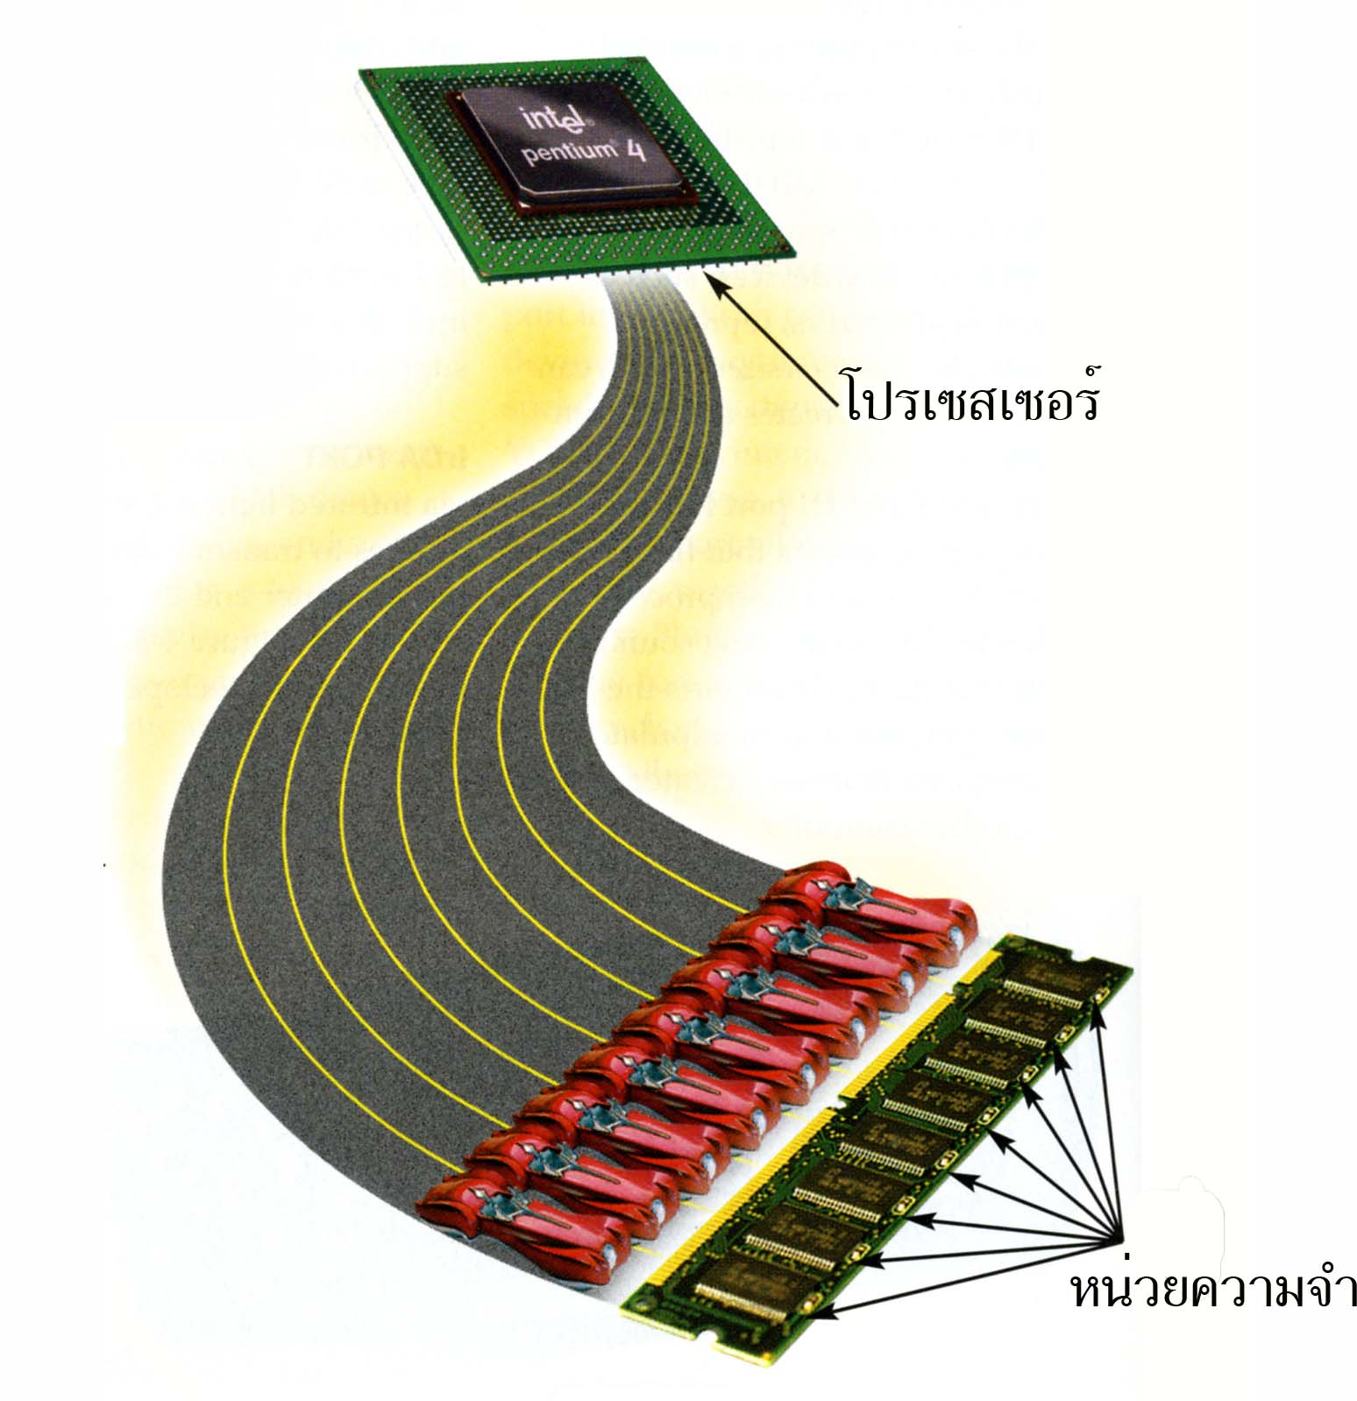

PHYSICAL BUS ARCHITECTURE
System bus is a number of parallel electrical conductors.
The conductors are metal lines etched in a card or printed circuit board. The bus extends across all of the components that taps into the bus lines, known as IDE cable: Integrated Drive Electronics or PATA: Parallel Advanced Technology Attachment.
SATA Serial Advanced Technology Attachment), is an IDE standard for connecting devices like optical drives and hard drives to the motherboard.

Slide 17
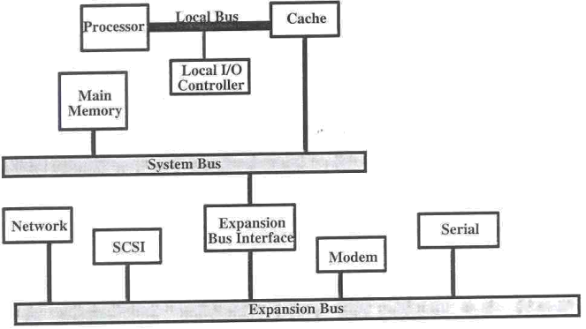
MULTIPLE-BUS HIERARCHIES
More devices attached to bus, propagation delays affect performance.
  How to arbitration?
Bottleneck as the aggregate data transfer demand approaches capacity of bus. (e.g graphics & video controller)
  How to increase bus?
  To overcome these problems, in most of the modern computers there are multiple buses
TRADITIONAL BUS ARCHITECTURE
Local bus: CPU - Cache
System bus: Main memory - Cache
Expansion bus:
I/O Modules - Main memory

Slide 18
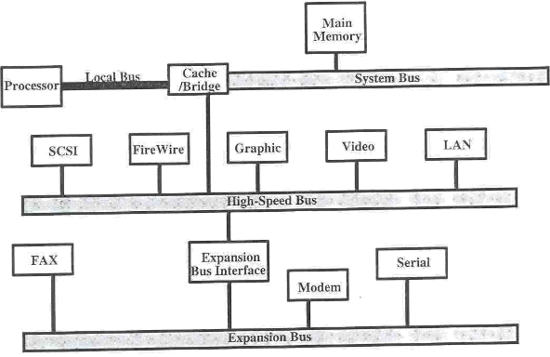
HIGH-PERFORMANCE ARCHITECTURE
Local bus: CPU - Cache/bridge
System bus: Cache/bridge - memory
High-speed bus: High-speed I/O module - Cache/bridge
Expansion bus: Low-speed I/O modules – Expansion interface

Slide 19
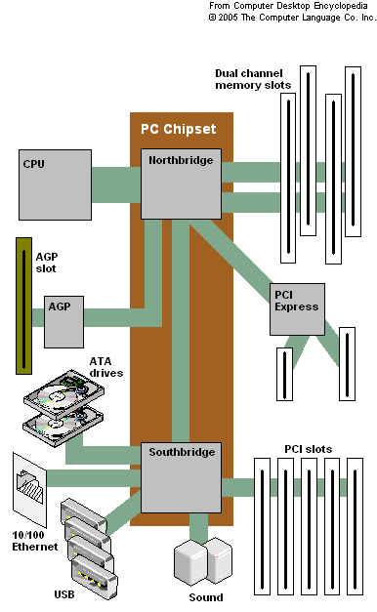
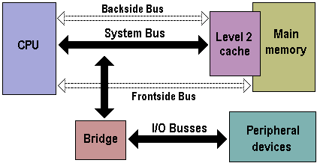

Slide 20
BUS DESIGN
1. TYPE:
Dedicated: permanent assigned bus either to one function or to a physical subset of computer components.
Multiplexed: Same bus may be used for various functions. Eg. same bus for address transfer and then for data transfer. The method of using the same bus for multple purposes is known as Time Multiplexing.
2. BUS WIDTH:
Address: Number of memory units that can be addressed
the wider of address bus has an impact on range of locations that can be referenced
Data: the wider of data bus has an impact on the number of bits transferred at one time.

Slide 21
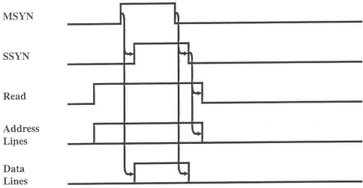
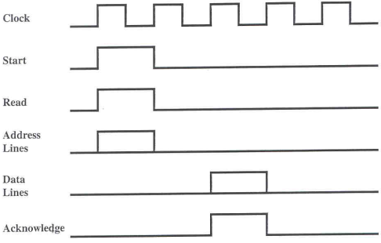
3. TIMING:
Synchronous: occurrence of events on the bus is determined by a clock (Clock Cycle or Bus Cycle) which includes line upon
Asynchronous: occurrence of one event follows and depends on the previous event.

Slide 22
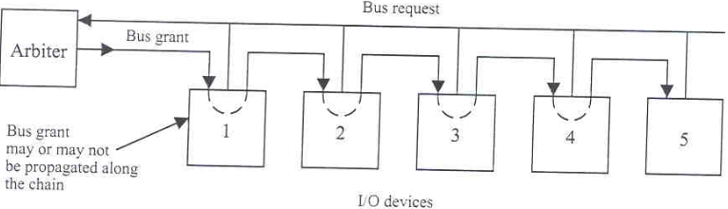
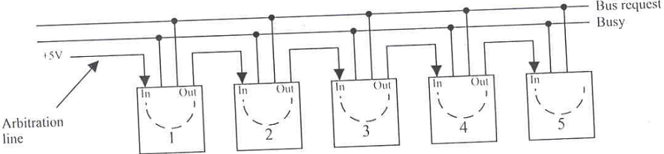
4. METHOD OF ARBITRATION:
Distributed In a distributed scheme, there is no central controller. Each module contains access control logic and the modules act together to share the bus
Centralized bus controller” (Arbiter),A single hardware device,is responsible for allocating time on the bus (daisy chain)

Slide 23
5. DATA TRANSFER TYPE:
Write Multiplexed: bus is used to specifying address and then transferring data (same as read operation).
Write Dedicated: data put on data bus as soon as the address has stabilized.
Read-modify-write: Address is broadcast once at beginning a simply read is followed immediately by a write to the same address.
Read-after-write: A write followed immediately by a read from the same address,performed for checking purposes.
Block: One address cycle is followed by n data cycles.
The first data item is transferred to or from the specified address; remainder data items are transferred to or from subsequent addresses.

Slide 24
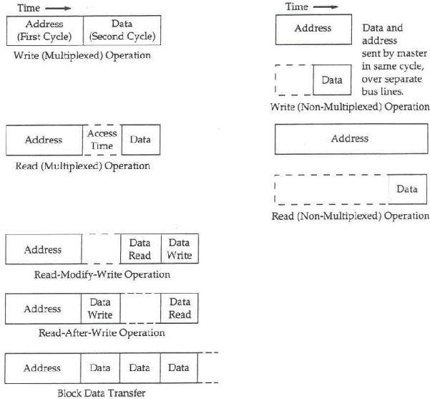

Slide 25
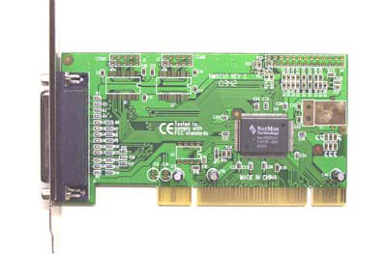

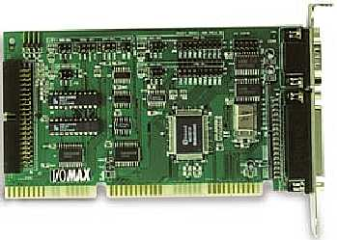

SAMPLES OF BUS
ISA (Industry Standard Architecture)
MCA (Micro Channel Architecture)
EISA (Extended ISA)
VL Bus (VESA Local Bus)
PCI Bus (Peripheral Connection Interface)
AGP (Accelerated Graphics Port)
Interface ports like USB (Universal Serial Bus), HDMI etc,….
PCI Card PCI Slot

Slide 26
ISA is a standard bus that allows 16 bits at a time to flow between the motherboard circuitry and an expansion slot card and its associated device(s).
MCA is an interface (with smaller pin connections) between a computer and its expansion cards and their associated devices.
EISA is a standard bus architecture that extends the ISA standard to a 32-bit interface with 33 megabytes per second.
VL bus (VESA Local Bus) is a standard interface between your computer and its expansion slot that provides faster data flow between the devices controlled by the expansion cards and your computer's microprocessor.
It is particularly effective in systems with advanced video cards and supports 32-bit data flow at 50 MHz
PCI is an interconnection system between a microprocessor and attached devices in which expansion slot are spaced closely for high speed operation. It is designed to be synchronized with the clock speed of the microprocessor, in the range of 33 to 66 MHz.

Slide 27
PCI is now installed on most new desktop computers and transmits 32 bits at a time in a 124-pin connection (the extra pins are for power supply and grounding) and 64 bits in a 188-pin connection in an expanded implementation.
PCI uses all active paths to transmit both address and data signals, sending the address on one clock cycle and data on the next.
PCI deliver better system performance for high-speed I/O subsystems
e.g. graphic display adapters, network interface controllers, disk controllers

Slide 28
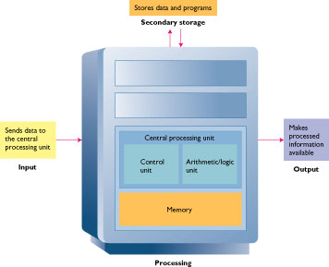
CENTRAL PROCESSING UNIT (CPU)
CENTRAL PROCESSING UNIT (CPU)
Central processing Unit
(CPU ) is a portion of computer system that carries out the instructions of computer program, to perform the basic arithimetical , logic and in put and out put operations of the system . It acts as the brain of computer.

Slide 29
CPU to do all its activities, needs to store some data temporarily. It must remember the location of the last instruction so that it can know where to get the next instruction. It needs to store instructions and data temporarily while an instruction is being executed. In other words, CPU needs a small internal memory.
MICROPROCESSOR COMPONENTS
Control Unit – CU
Arithmetic / Logic Unit – ALU
Registers
System clock

Slide 30
The central processing unit (CPU) of a computer is the main unit that dictates the rest of the computer organization.
1. Register set: Stores intermediate data during the execution of instructions;
2. Arithmetic logic unit (ALU): Performs the required micro-operations for executing the instructions;
3. Control unit: supervises the transfer of information among the registers and instructs the ALU as to which operation to perform by generating control signals.
4. System Clock: provides a timing pulse measure in microseconds to control the sequencing of instructions. CPU performance is often measured in cycles per second (Hertz) and is often clocked at millions (MHz) and billions (GHz) of cycles.
That CPU is the part of the computer that carries out computation based on two operations:
  Arithmetic operations: start with basic addition and includes subtraction, multiplication, and division.
  Logical operations: comparing two things (e.g., two numbers).

